Slide 1
Introduction to Database

Slide 2
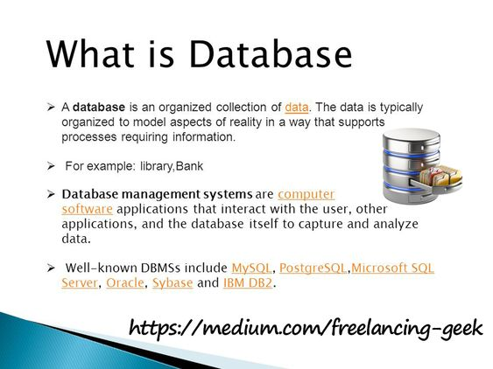

Slide 3
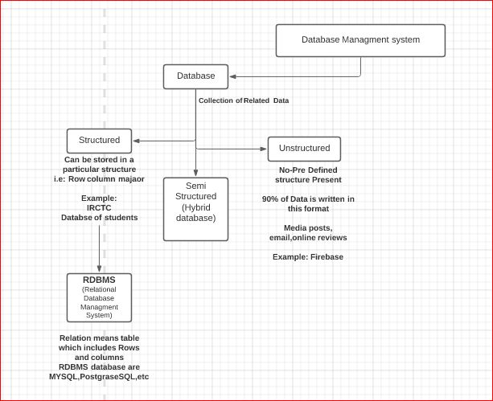
Data is stored in json and xml
Format and also in csv format

Slide 4
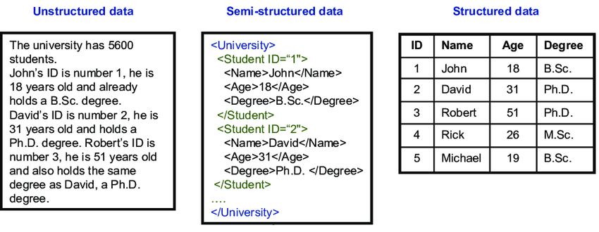
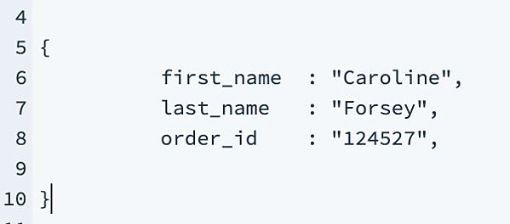

Slide 5
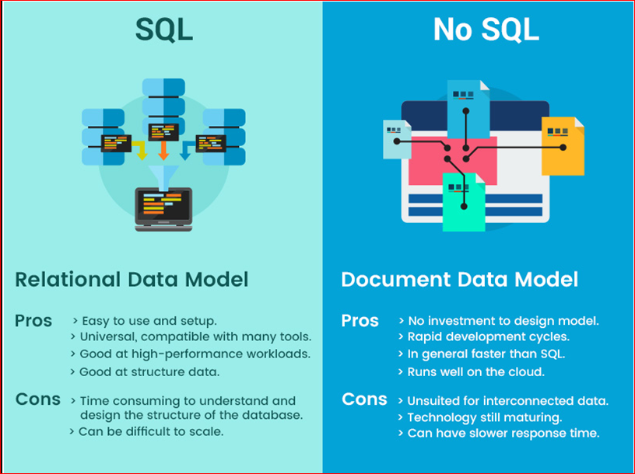
SQL vs NOSQL

Slide 6
Database architecture
2-level architecture
3-level architecture

Slide 7
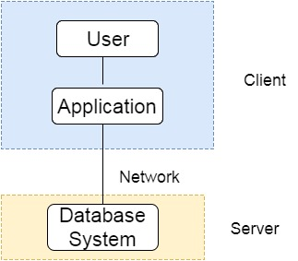
Two tier architecture:

Slide 8
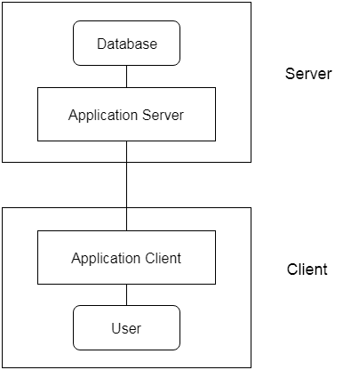
Three level architecture

Slide 9
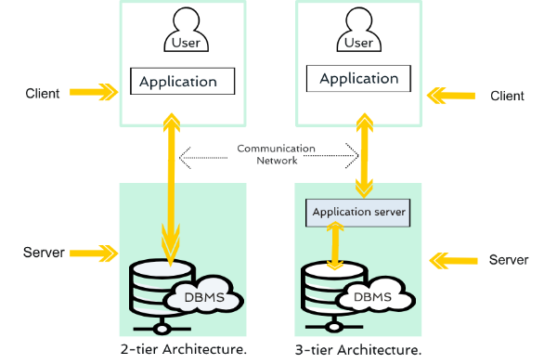
Difference

Slide 10
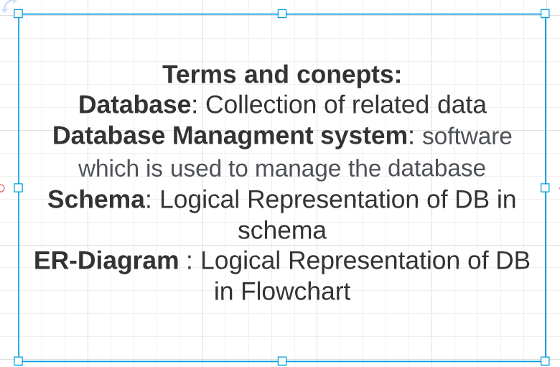

Slide 11
